Slide 1
Lab 3 Introduction
Operating Systems, EDA093 - DIT400

Slide 2
Lab Overview
Pintos
Main challenge: Synchronize access to a shared resource.
Schedule jobs for an external hardware accelerator (e.g. GPU, co-processor) that send and receive data through a common bus.

Slide 3
Bridge Problem
A two way east-west road contains a narrow bridge with only one lane. An eastbound (or westbound) car can pass over the bridge only if there is no oncoming car on the bridge. Traffic may only cross the bridge in one direction at a time, and if there are ever more than 3 vehicles on the bridge at one time, it will collapse under their weight. In this system, each car is represented by one thread, which executes the procedure OneVehicle when it arrives at the bridge.
OneVehicle(Direction direc) {
ArriveBridge(direc);
CrossBridge(direc);
ExitBridge(direc); }
direc gives the direction in which the vehicle will cross the bridge

Slide 4
Bridge Problem - Solution
Correctness Constraints
At most 3 cars are on the bridge at a time
All cars on the bridge go in the same direction
Whenever the bridge is empty and a car is waiting, that car should get on the bridge
Whenever the bridge is not full and a car is waiting to go the same direction as the cars on the bridge, that car should get on the bridge
Cars will be waiting to get on the bridge, but in two directions. Use an array of two condition variables, waitingToGo[2].
It will be necessary to know the number of cars on the bridge (cars, initialized to 0), and the direction of these cars if there are any (call it current-direction). It will also be useful to know the number of cars waiting to go in each direction; use an array waiters[2].

Slide 5
Bridge Problem - Solution
ArriveBridge(int direction) {
lock.acquire();
// while can't get on the bridge, wait
while ((cars == 3) || (cars > 0 && currentdirection != direction)) {
waiters[direction]++;
waitingToGo[direction].wait();
waiters[direction]--;
}
// get on the bridge
cars++;
currentdirection = direction;
lock.release();
}

Slide 6
Bridge Problem - Solution
ExitBridge() {
lock.acquire();
cars--;
// if anybody wants to go the same direction, wake them
if (waiters[currentdirection] > 0)
waitingToGo[currentdirection].signal();
// else if empty, try to wake somebody going the other way
else if (cars == 0)
waitingToGo[1-currentdirection].broadcast();
lock.release();
}

Slide 7
Lab Task
Classical IPC Problem
Implement a Shared bus system
Up to 3 threads of the same direction can use bus concurrently
High priority threads ahead of low priority
No need to consider fairness!
Prototype functions already implemented in:
src/devices/batch-scheduler.c

Slide 8
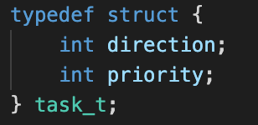
Lab Task
{SENDER, RECEIVER}
{NORMAL, HIGH}

Slide 9
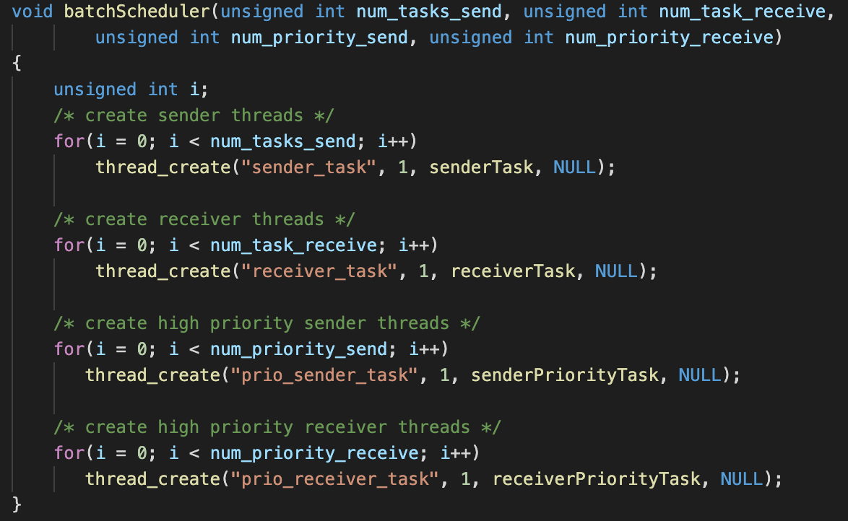
Lab Task

Slide 10
Lab Task
DO NOT CHANGE/ADD ANY CODE HERE

Slide 11
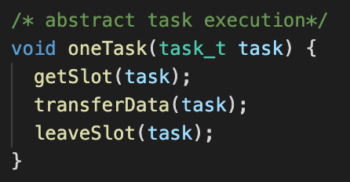
Lab Task
You need to implement the following three functions:
If you print in any of these functions, you might get a timeout and fail the test.

Slide 12
Assignment Overview
The lab assignment will involve 2 objectives:
Modifying the Pintos code
Writing a report that explains your solution
Execute command “make check” in the ~/pintos/src/threads directory to run the test.
! The automated test only determines that the execution terminates

Slide 13
Submission
Test the code
Write the report
Prepare the archive

